Slide 1
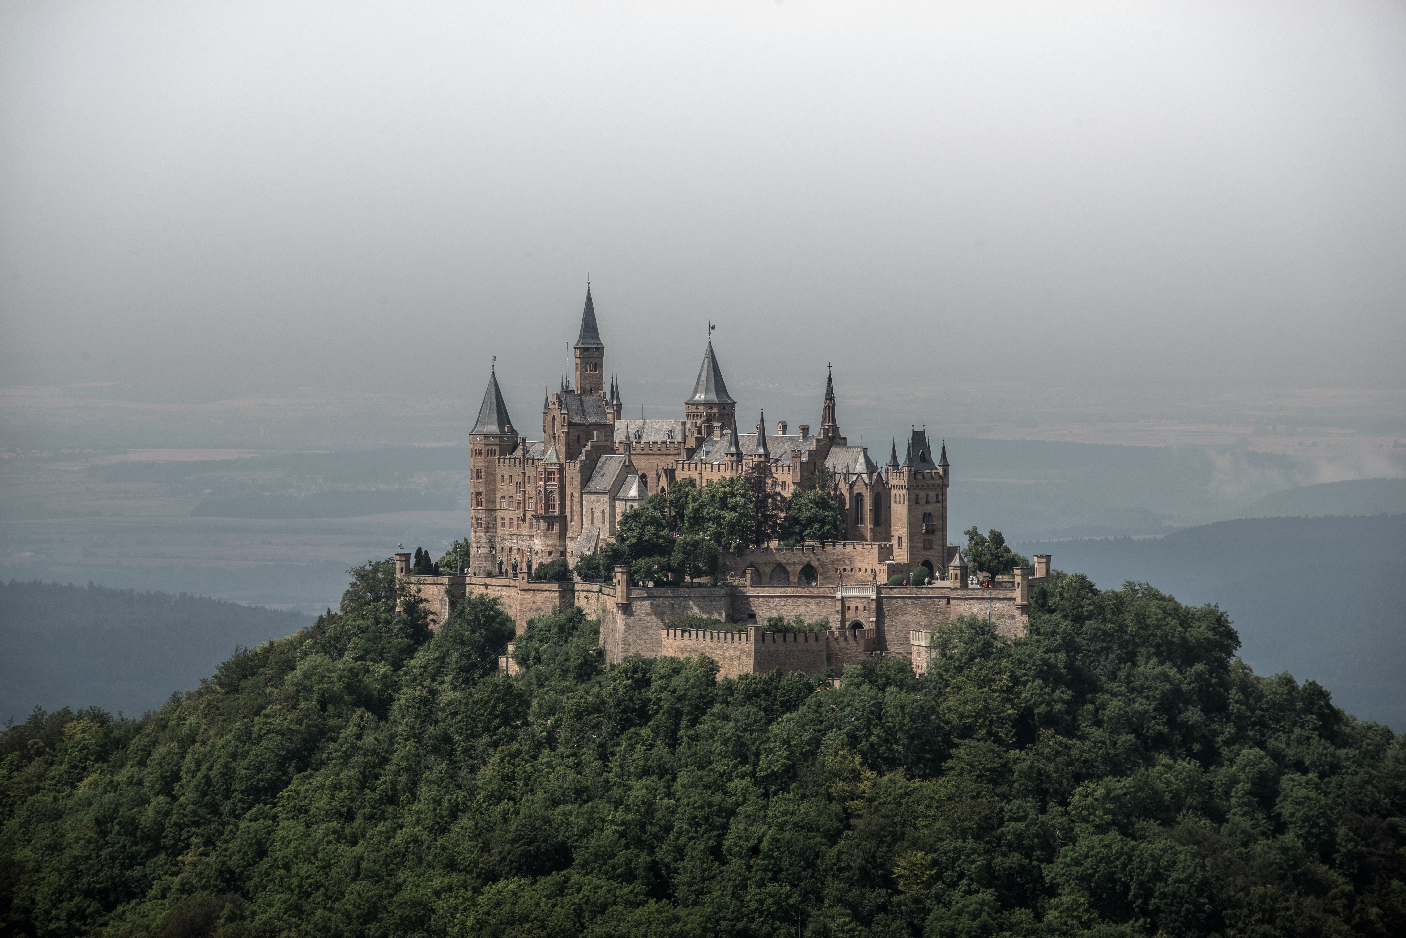
Spooky Places of Scotland – A Web App

Slide 2
Aims & Learning Outcomes:
Create a simple educational website, that teaches about derelict/spooky places across Scotland.
Simple and intuitive user interface (view content loaded from db, basic filtering, add/remove favourites).
Outcomes:
Understand full-stack development process;
- Consolidate and expand on technology covered (Vue js, Vue js router, Leaflet, Express and Mongo DB)

Slide 3
Planning:
Challenges in API choice;
Resort to building own API;
Basic design – simple planning;

Slide 4
Challenges
Collaboration – distributing workload and git approach.
Finding direction.
Leaflet – single mount and zooming issues.
Data querying – server side or client side?
Late implementation of Vue router and refactoring.
Responsive design – CSS as a programming language and time constraints.

Slide 5
Room for improvement
Incorporate an external API (places to eat within a radius of ..)
From educational to services website (admin/user areas, tours info and booking)
Fully responsive design.

Slide 6
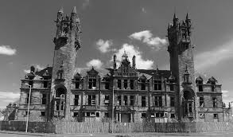
Demo, questions and bye

